Slide 1
Details of Regularization

Slide 2
Learning Goals
In this section, we will cover:
- Details of regularization
- Approaches to understanding how regularization works

Slide 3
Understanding how Regularization Works
Having worked through some Regularization examples, let's examine intuitively how these techniques (Ridge, LASSO, Elastic Net) interact with modeling.
There are several approaches to this interpretation:
- The Analytic View
- The Geometric View
- The Probabilistic View

Slide 4
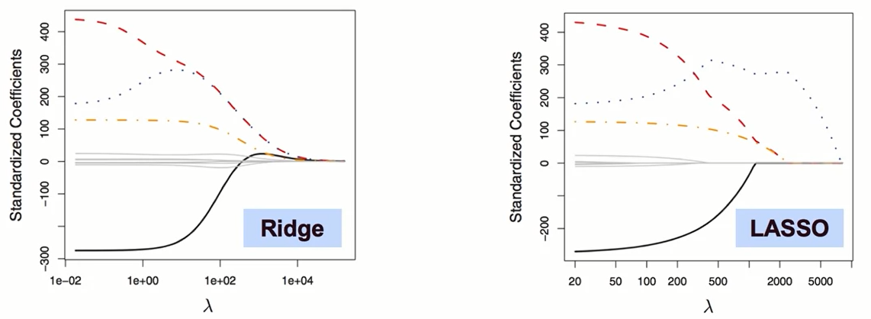
The Analytic View
Increasing L2/L1 penalties force coefficients to be smaller, restricting their plausible range.
A smaller range for coefficients must be simpler/lower variance than a model with an infinite possible coefficient range.

Slide 5
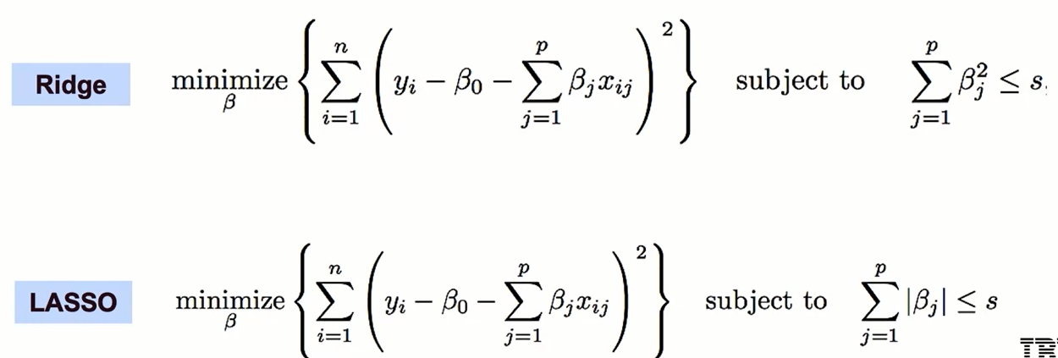
The Geometric View
Below are mathematically equivalent formulations of the optimization objectives of Ridge/LASSO

Slide 6
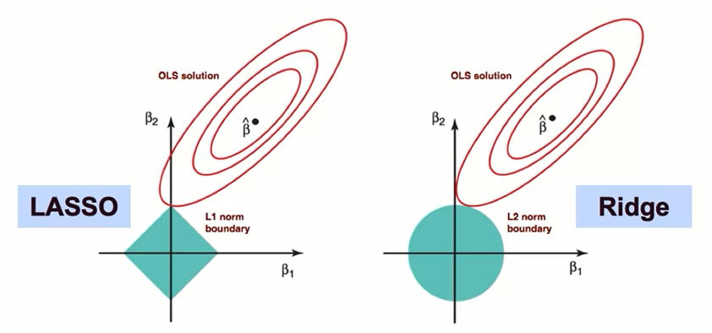
The Geometric View
Under this geometric formulation, the cost function minimum is found at the intersection of the penalty boundary and a contour of the traditional OLS cost function surface.
The geometry reveals the selection effect of LASSO
(intersection at a corner/axis zeroes out coefficients).

Slide 7
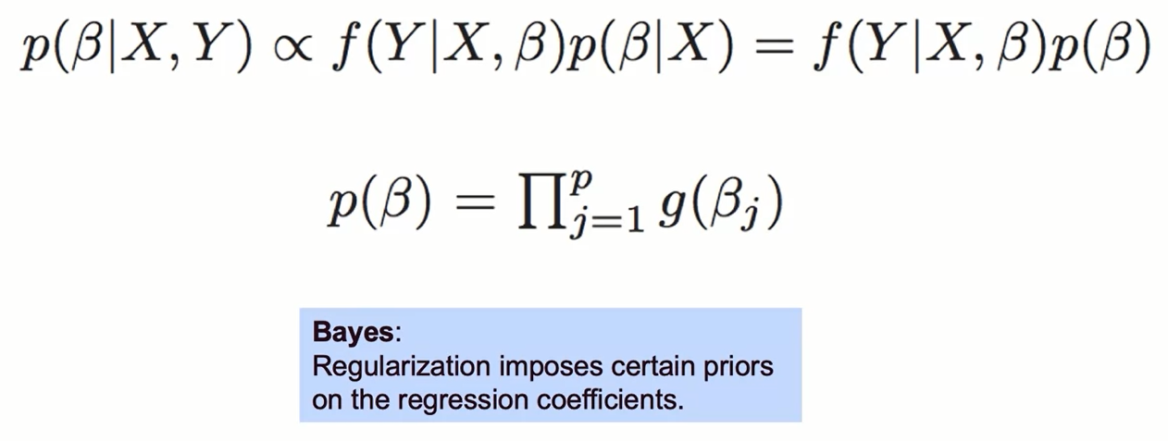
The Probabilistic View

Slide 8
The Probabilistic View
Letting f be the likelihood (probability of target given parameter vector 𝛃), and p(𝛃) the prior distribution of 𝛃, we can calculate the posterior of 𝛃.
p(𝛃) is derived from independent draws of a prior coefficient density function g that we choose when regularizing.
L2 (ridge) regularization imposes a Gaussian prior on the coefficients, while L1 (lasso) regularization imposes a Laplacian prior.

Slide 9
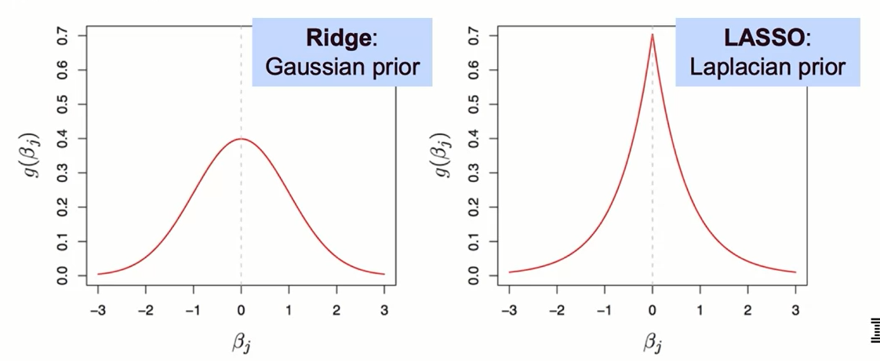
The Probabilistic View
Visualizing these prior distributions again reveals the difference in behavior between Ridge and LASSO: the Laplacian distribution has peaked density at 0, explaining its tendency to zero out some coefficients.

Slide 10
Regularization Recap
Complexity Tradeoff
Reduce complexity by penalizing it in cost function.
Increases bias, but reduces variance (may be worth the trade-off).
Options: L2, L1, can validate the choice and strength.

Slide 11
Regularization Recap
Regularization
Optimizing predictive models is about finding the right bias/variance tradeoff.
We need models that are sufficiently complex to capture patterns in data, but not so complex that they overfit.

Slide 12
Regularization Recap
How it Works
Analytically: penalty constrains the coefficient range.
Geometrically: L1/L2 imposes bounded regions.
Probabilistically: imposes prior on coefficients.

Slide 13
Summary
Regularization Techniques
Three sources of error for your model are: bias, variance, and, irreducible error.
Regularization is a way to achieve building simple models with relatively low error. It helps you avoid overfitting by penalizing high-valued coefficients. It reduces parameters and shrinks the model.
Regularization adds an adjustable regularization strength parameter directly into the cost function.
Regularization performs feature selection by shrinking the contribution of features, which can prevent overfitting.

Slide 14
Summary
Regularization Techniques
In Ridge Regression, the complexity penalty λ is applied proportionally to squared coefficient values.
The penalty term has the effect of “shrinking” coefficients toward 0.
This imposes bias on the model, but also reduces variance.
We can select the best regularization strength lambda via cross-validation.
It’s a best practice to scale features (i.e. using StandardScaler) so penalties aren’t impacted by variable scale.
In LASSO regression: the complexity penalty λ (lambda) is proportional to the absolute value of coefficients. LASSO stands for : Least Absolute Shrinkage and Selection Operator.
Similar effect to Ridge in terms of complexity tradeoff: increasing lambda raises bias but lowers variance.
LASSO is more likely than Ridge to perform feature selection, in that for a fixed λ, LASSO is more likely to result in coefficients being set to zero.

Slide 15
Summary
Regularization Techniques
Elastic Net combines penalties from both Ridge and LASSO regression. It requires tuning of an additional parameter that determines emphasis of L1 vs. L2 regularization penalties.
LASSO’s feature selection property yields an interpretability advantage, but may underperform if the target truly depends on many of the features.
Elastic Net, an alternative hybrid approach, introduces a new parameter α (alpha) that determines a weighted average of L1 and L2 penalties.
Regularization techniques have an analytical, a geometric, and a probabilistic interpretation.

Slide 16
Learning Recap
In this section, we discussed:
- Details of regularization
- Approaches to understanding how regularization works

